Slide 1
Module 3 Guided Lab - Hosting a Static Website
Made for Professor Lanham A. by Amrit Singh

Slide 2
AGENDA
Accessing the AWS management console
Task 1 : Creating a bucket in Amazon S3
Task 2 : Uploading content to your bucket
Task 3 : Enabling access to the objects
Task 4 : Updating the website

Slide 3
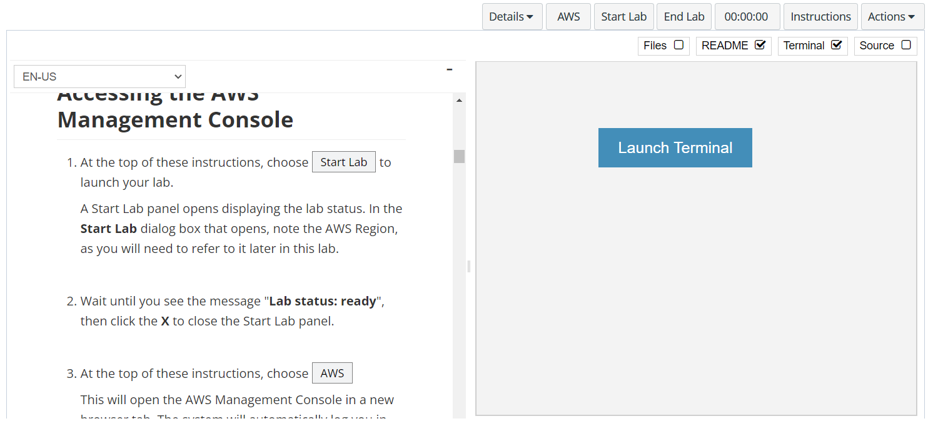
In aws labs click on start lab

Slide 4
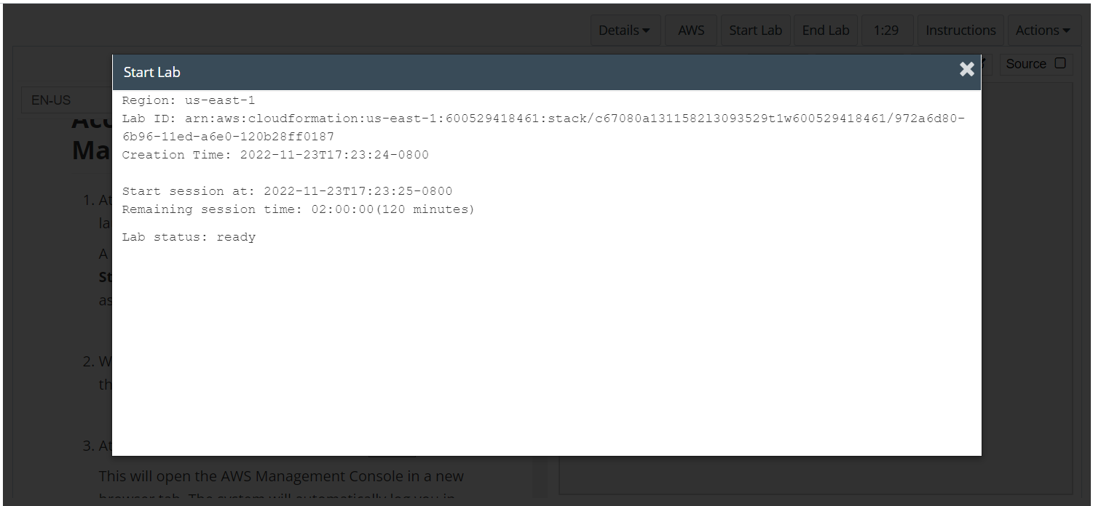
Wait to see lab ready status in the window then press x and click on aws to launch console

Slide 5
Task 1 : Creating a bucket in Amazon S3

Slide 6
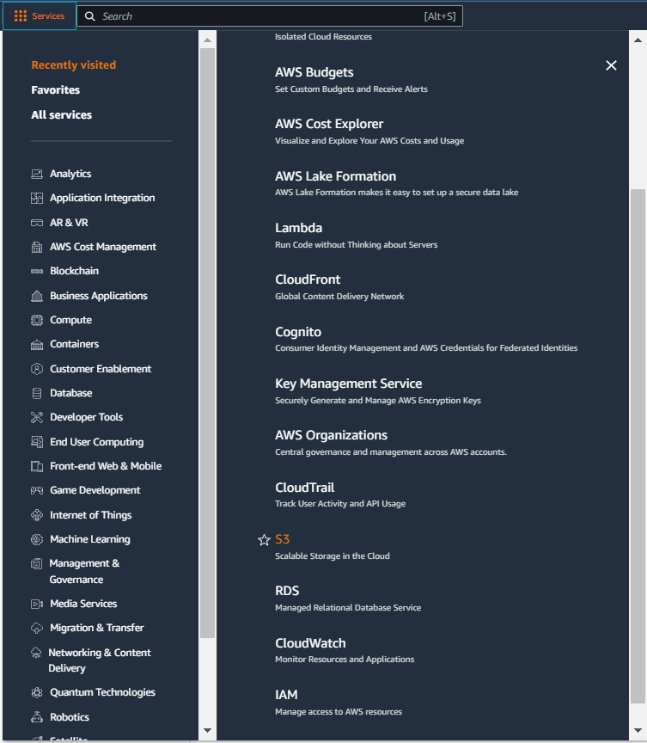
Select services and then click on S3 button
Click on the Services button
Click on the S3 button

Slide 7
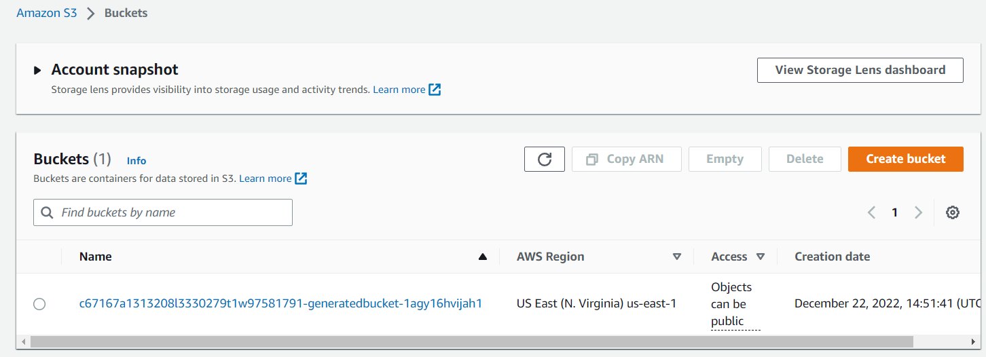
Click on create bucket button
Click on create bucket button

Slide 8
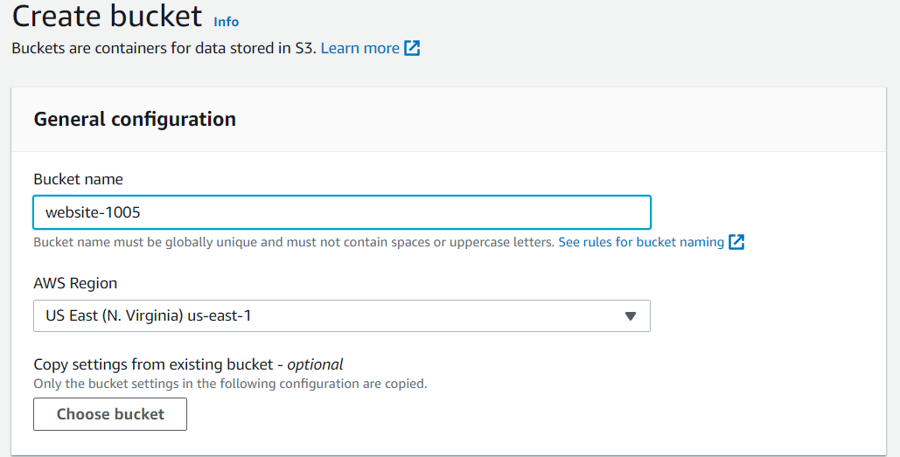
Set the bucket name and aws region

Slide 9
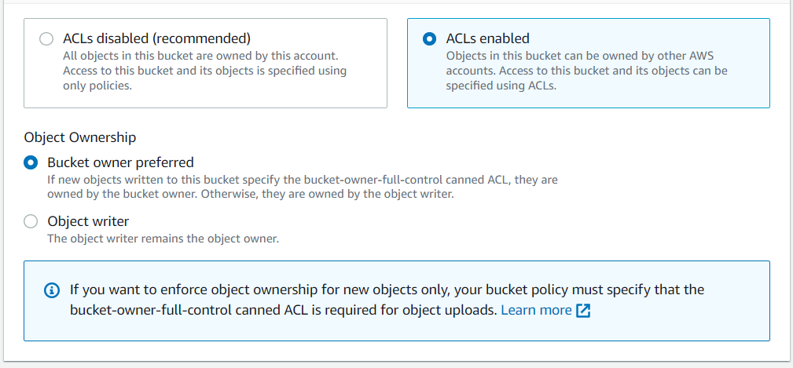
select acl enabled setting and choose bucket owner preferred

Slide 10
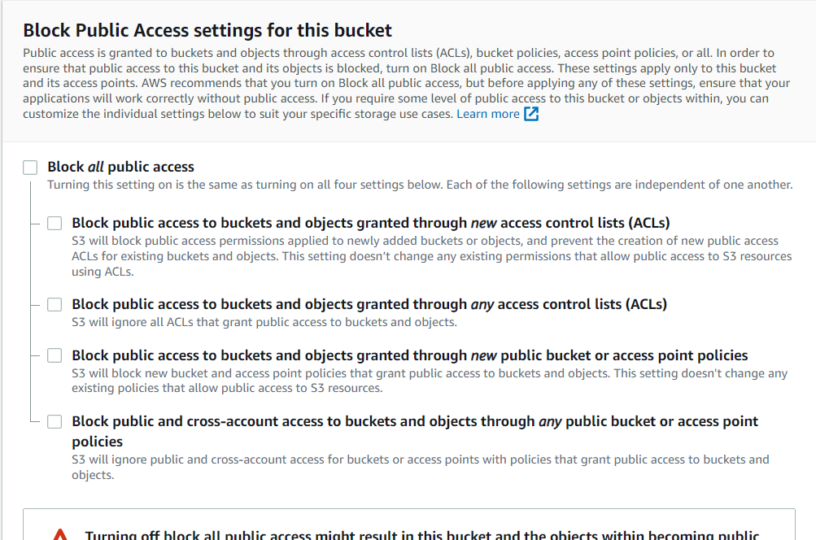
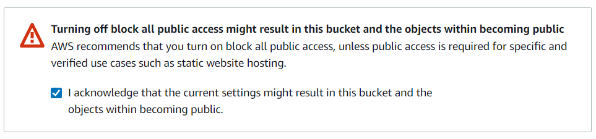
Uncheck block public access setting and acknowledge the settings and then click create bucket

Slide 11
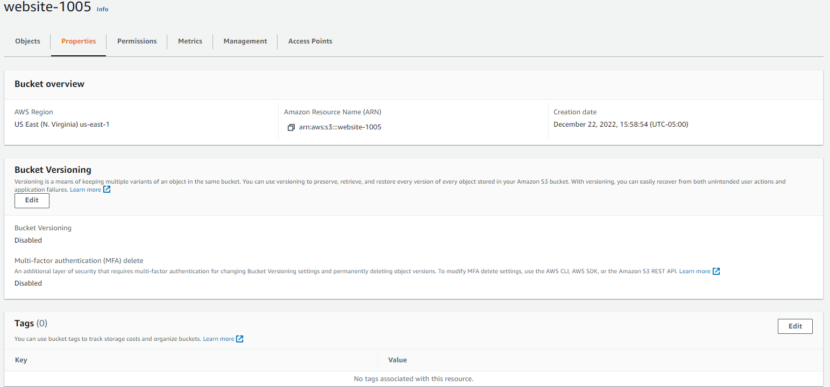
Choose the bucket and then select properties and then click on edit tags
Click on Edit

Slide 12
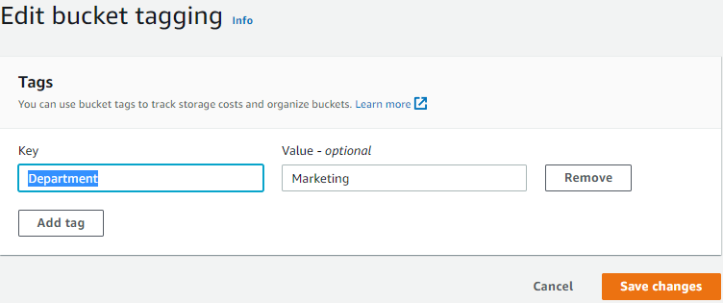
Click on add tags with key – Department and value – marketing and then save changes

Slide 13
In properties on Static website hosting click on edit button

Slide 14
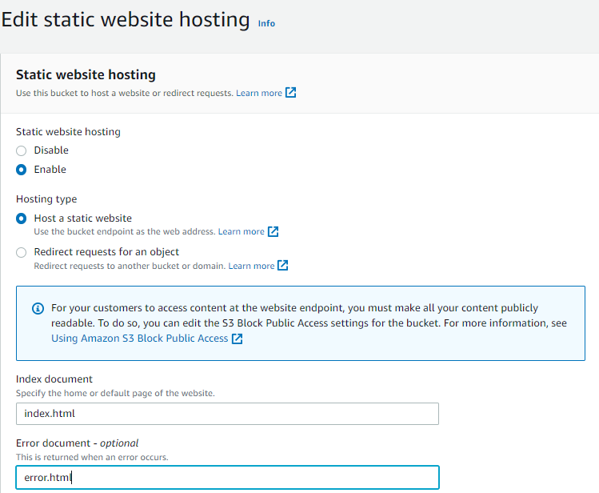
Update the relevant details in the static website hosting as per the aws labs and then click on save changes

Slide 15
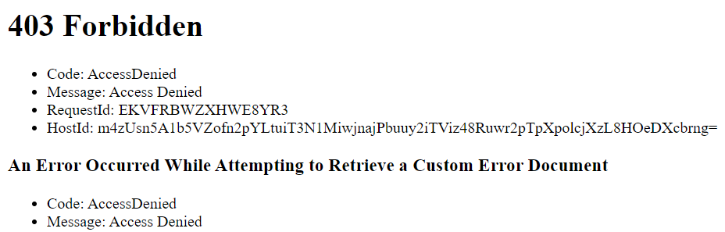
Copy the static website endpoint in the browser but error 404 would comeup because of bucket permissions

Slide 16
Task 2 : Uploading content to your bucket

Slide 17
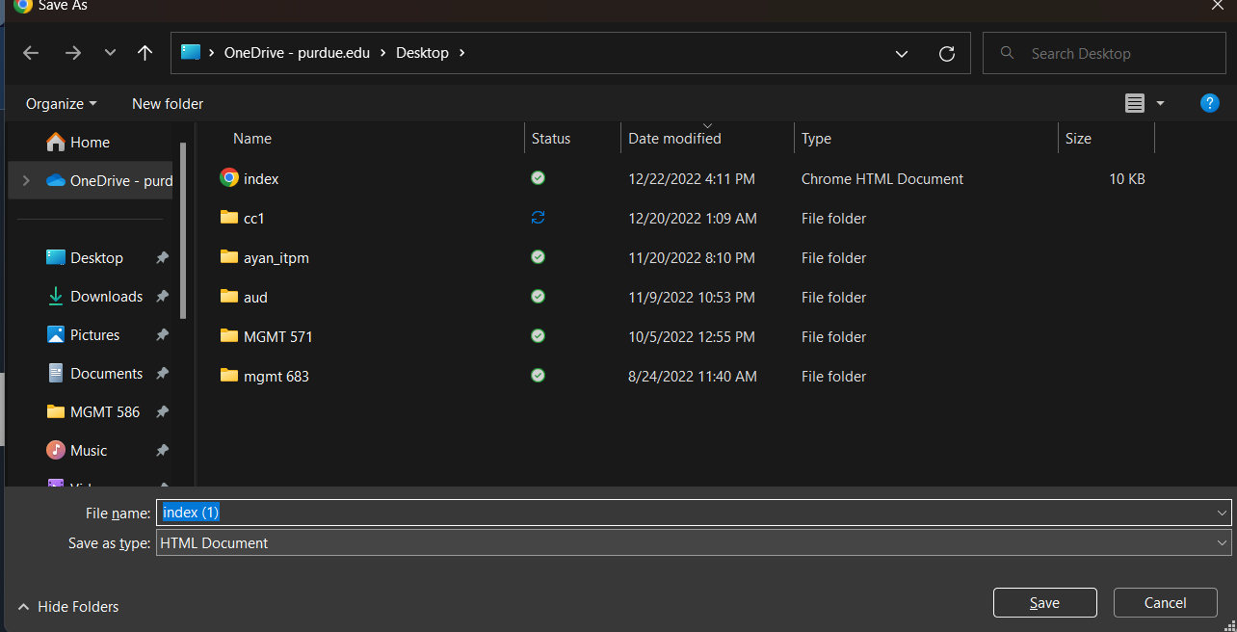
Download the links in aws labs to your personal machine with the same name

Slide 18
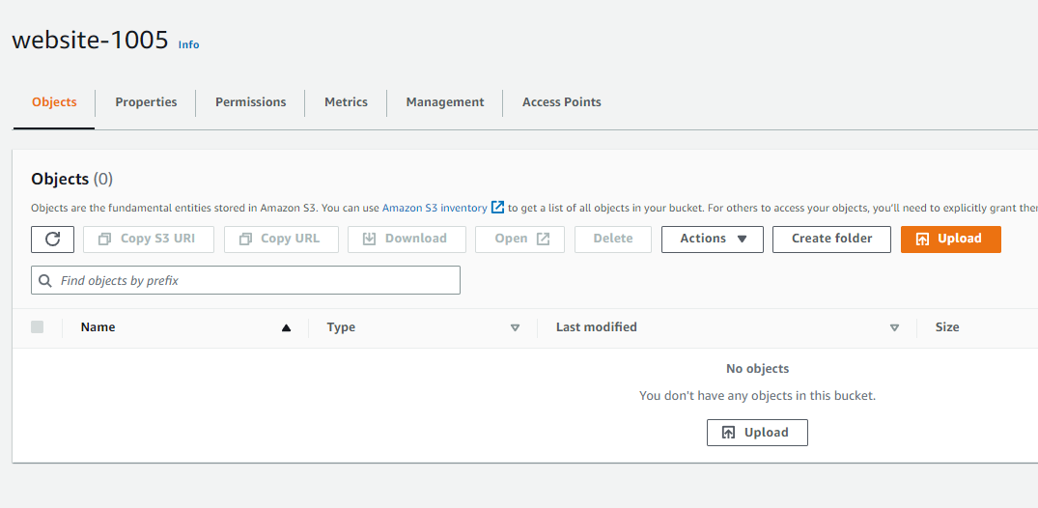
Under the bucket settings in objects click on upload button

Slide 19
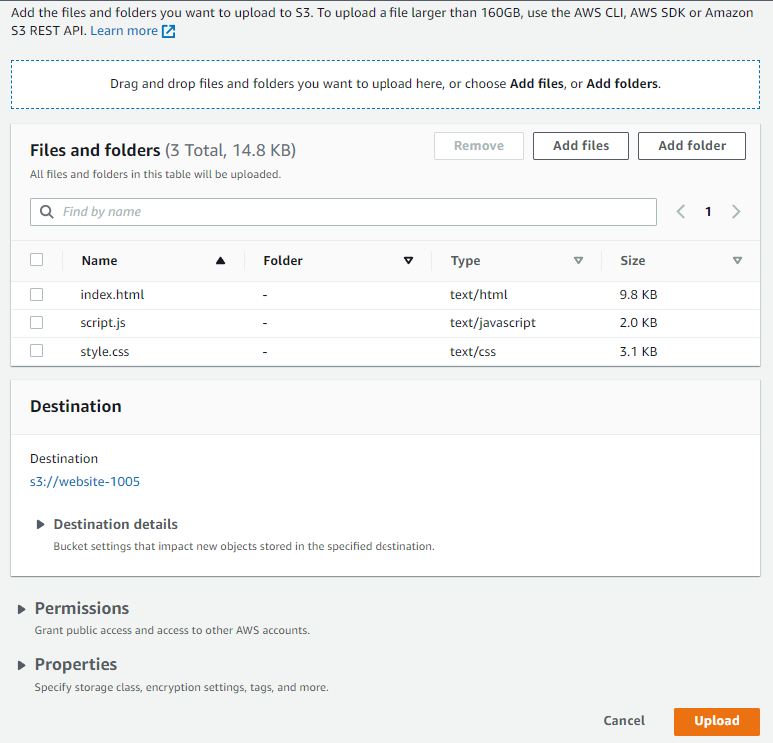
add the 3 files and click upload

Slide 20
Task 3 : Enabling access to the objects

Slide 21
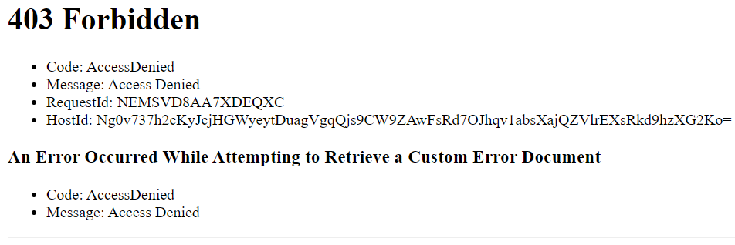
Refresh the webpage to still find error 404 message

Slide 22
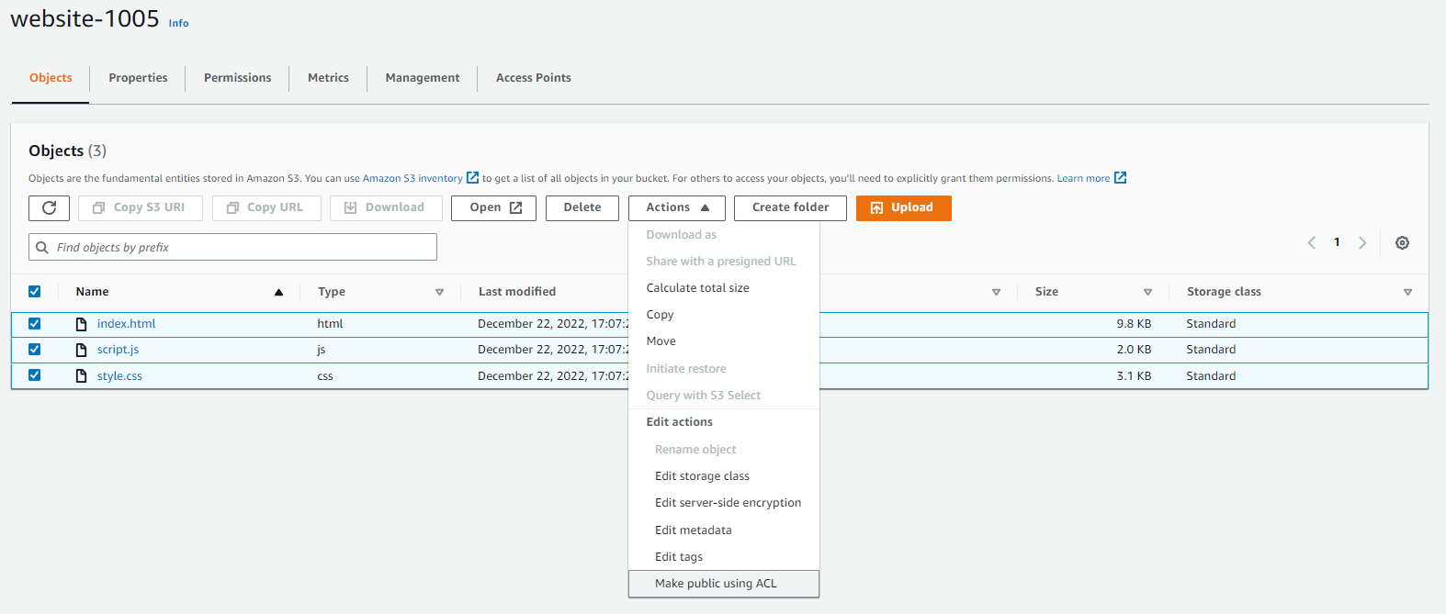
Select the 3 files and then click make public via acl in actions menu

Slide 23
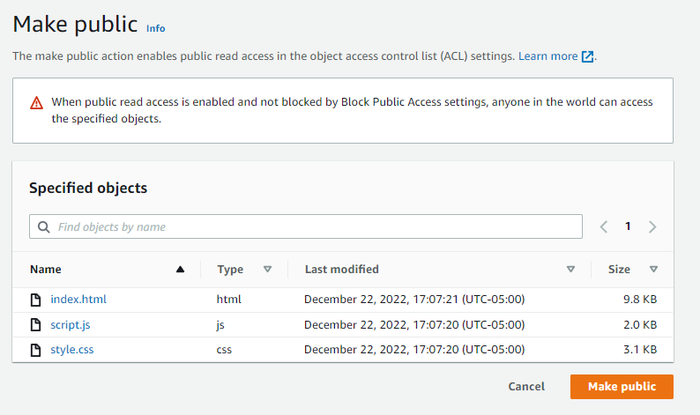
Click on make pubic button

Slide 24
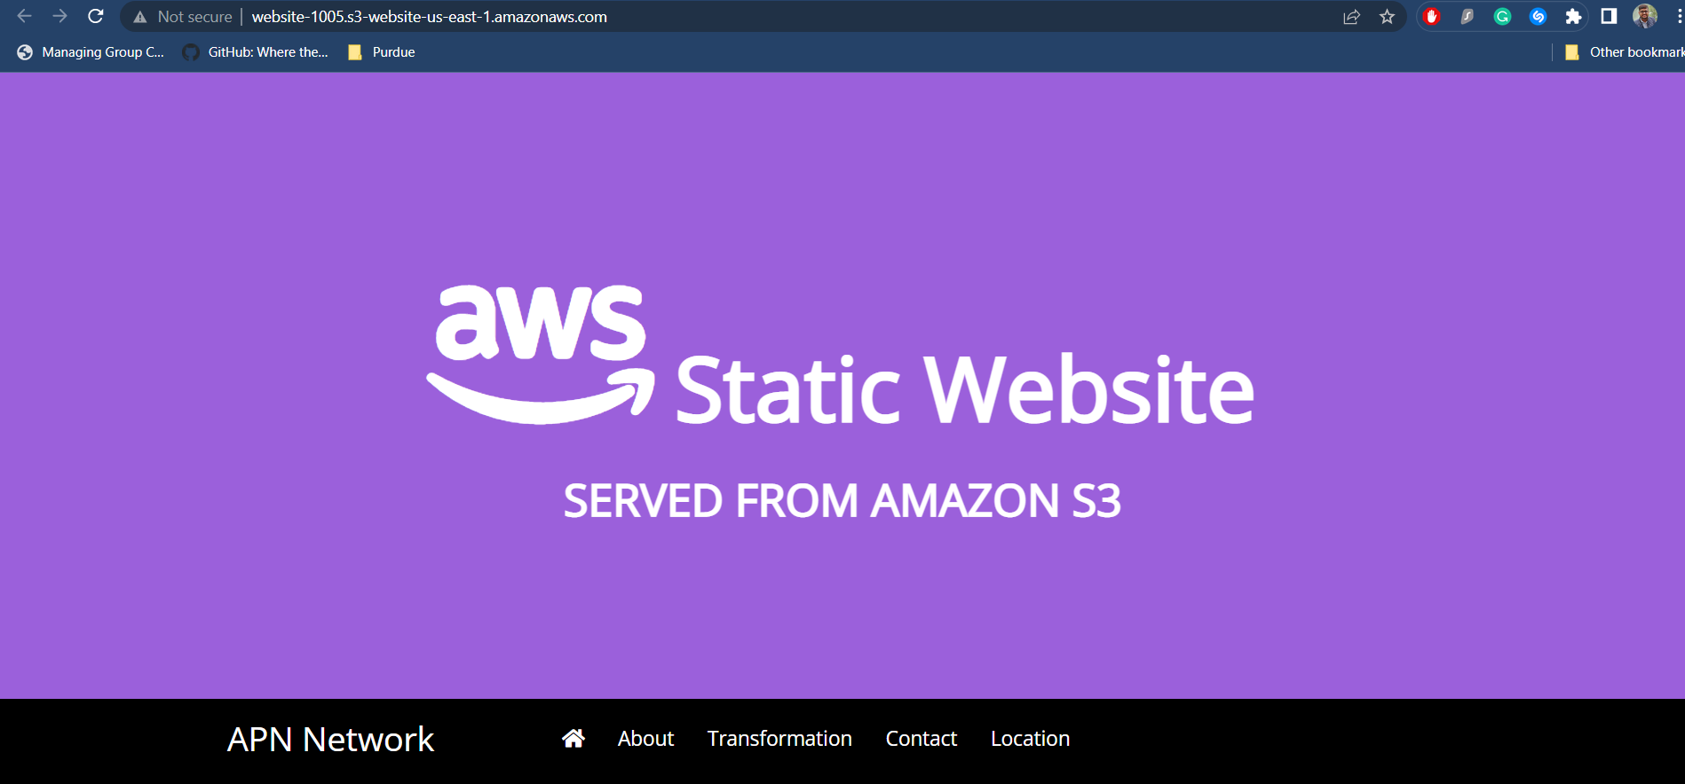
On refreshing the webpage again we can see that the page loads up

Slide 25
Task 4 : Updating the website

Slide 26
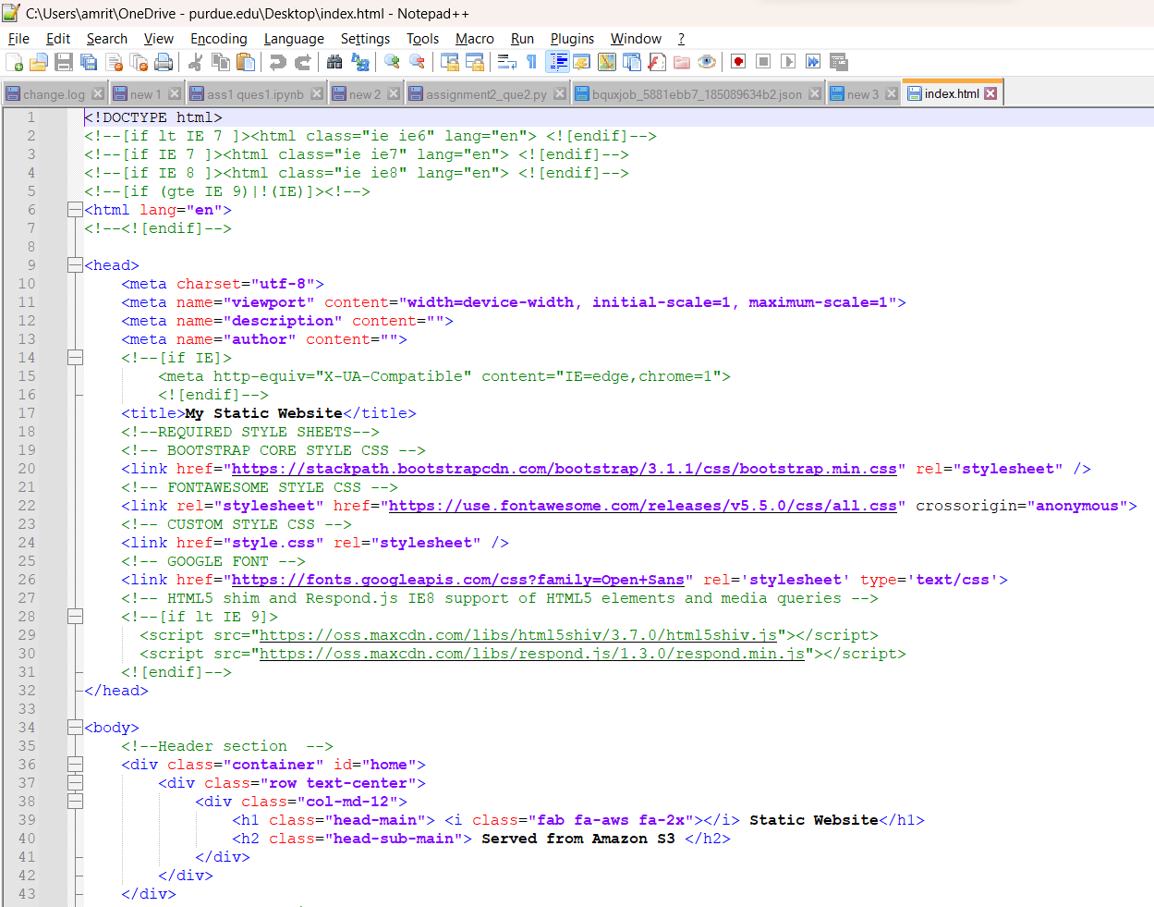
Open index.html file in notepad++

Slide 27
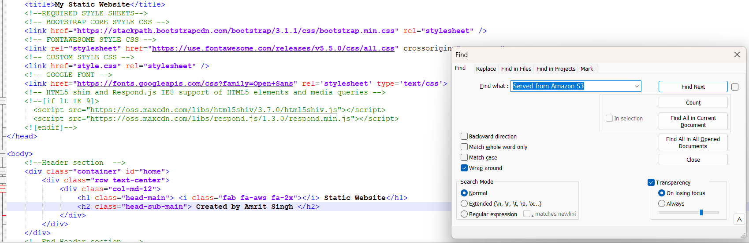
Find ‘served from s3’ in the file and replace with ‘created by <your name>’

Slide 28
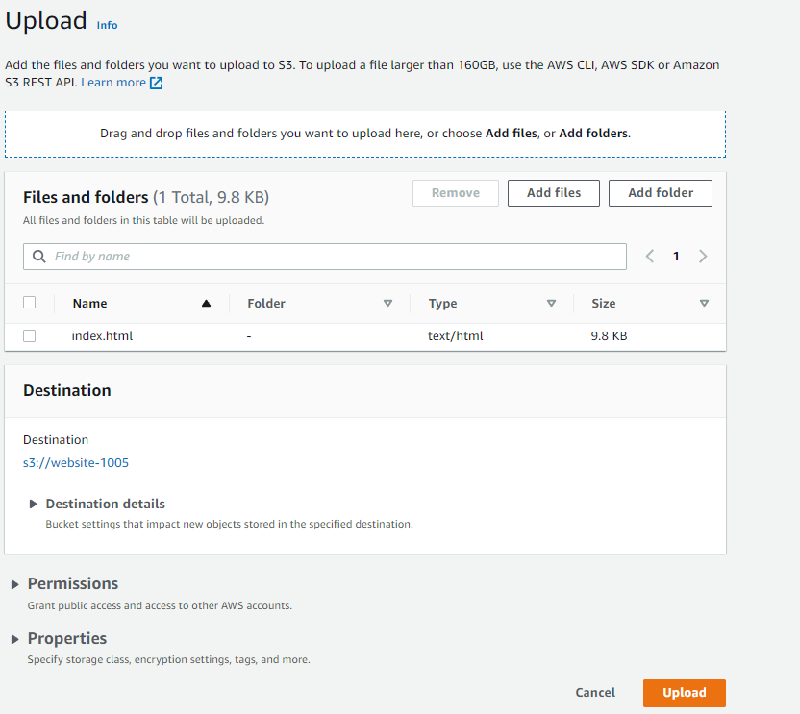
Delete the old index.html from s3 and upload the new index.html file from your computer back to s3

Slide 29

Make the index.html file public via acl and then refresh the page to see the updated static website page

Slide 30
THANK YOU
Amrit Singh

